Slide 1

Tutorial T3 Derek Tan, Andre Oliver Jessica Ying, Lily Zhang

Slide 2
Roles
Derek: Administrator
Jessica: Research and Repository Manager
Lily: Mechanical Engineer
Andre: Mechanical Engineer

Slide 3
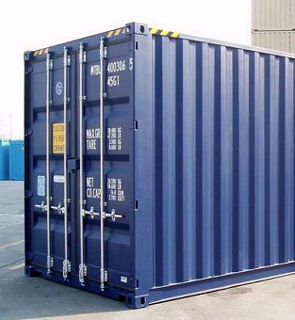
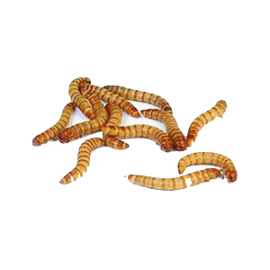
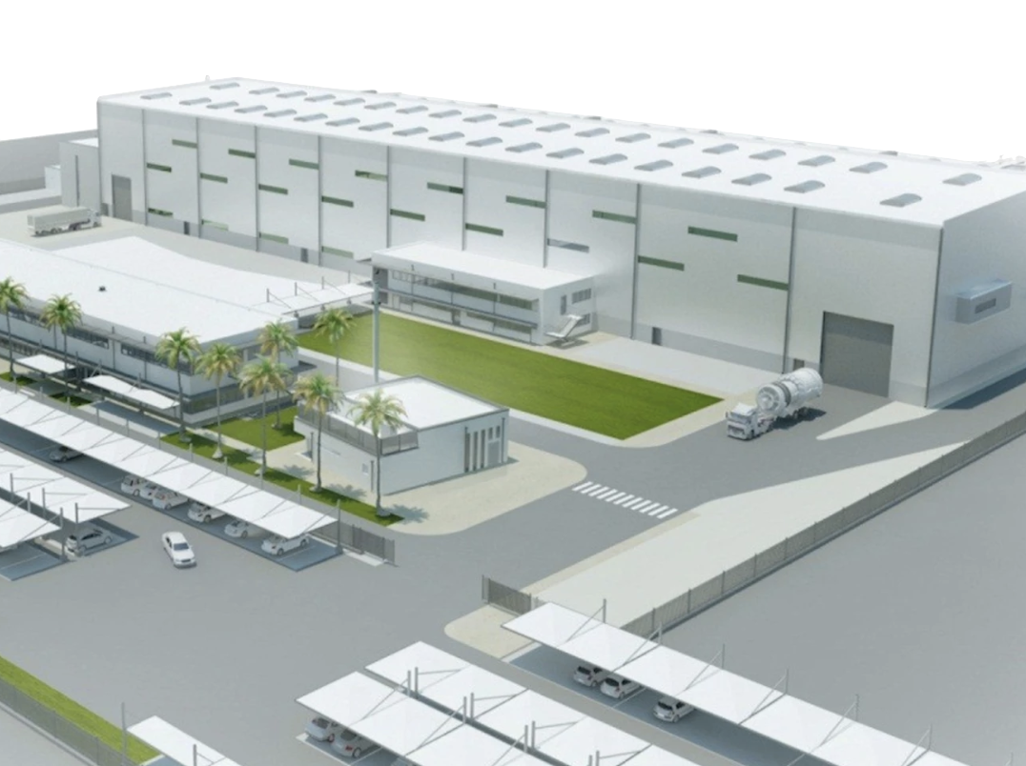
Our Project

Slide 4

Relavent Stakeholders
Project team
Project client
Potential customers
Shadow team
Third party supervisor

Slide 5
Rendering Process Overview
Breaking/
Pre-cooking
Continuous Cooking
Separation
Natural Oils
Black Soldier Fly Larvae
Protein Meal

Slide 6
Rendering Process Components
Breaking/Pre-cooking
Breaking Machine
Drainer
Pre-Cooker
Water Evaporator
Continuous Cooking
Large Cooking Chamber/ Chambers
Heating Chamber
Pressure Chamber
Separation
Percolation Process
Industrial Decanter
Fat Press
Separator

Slide 7
Preliminary Design Options
OR
B & PC
CC
B & PC
CC
SEP
CC
SEP
20/40 feet
SEP
40 feet

Slide 8
Risks and Resources
Financial Risks
Inaccurate Cost Projections
Over-Engineered Design
Poorly Engineered Design
Material Risks
Inadequate Cooling
Pressure Build-Up
Inadequate Supporting Structure
Limited Access

Slide 9
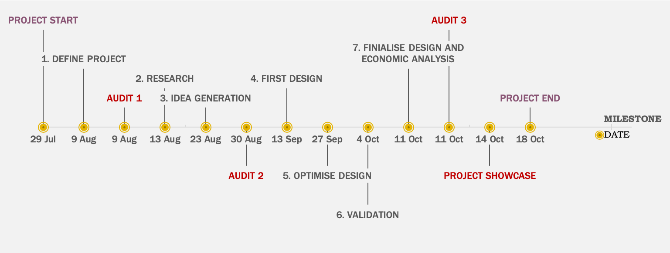
Milestone

Slide 10
WBS using Gantt Chart
Phase 1
Concept of Operation / Project Initialisation
Phase 2
Engineering Governance
Phase 3
Project Execution
Phase 4
Project Delivery

Slide 11
Final Output of the Project
Properly modelled insect processing plant design
A manual that introducing the design detail
The overall cost estimation
The documentations on recording the procedures through the semester, including systematic and technical analysis, decision log and meeting records.
Design evaluation and validation

Slide 12
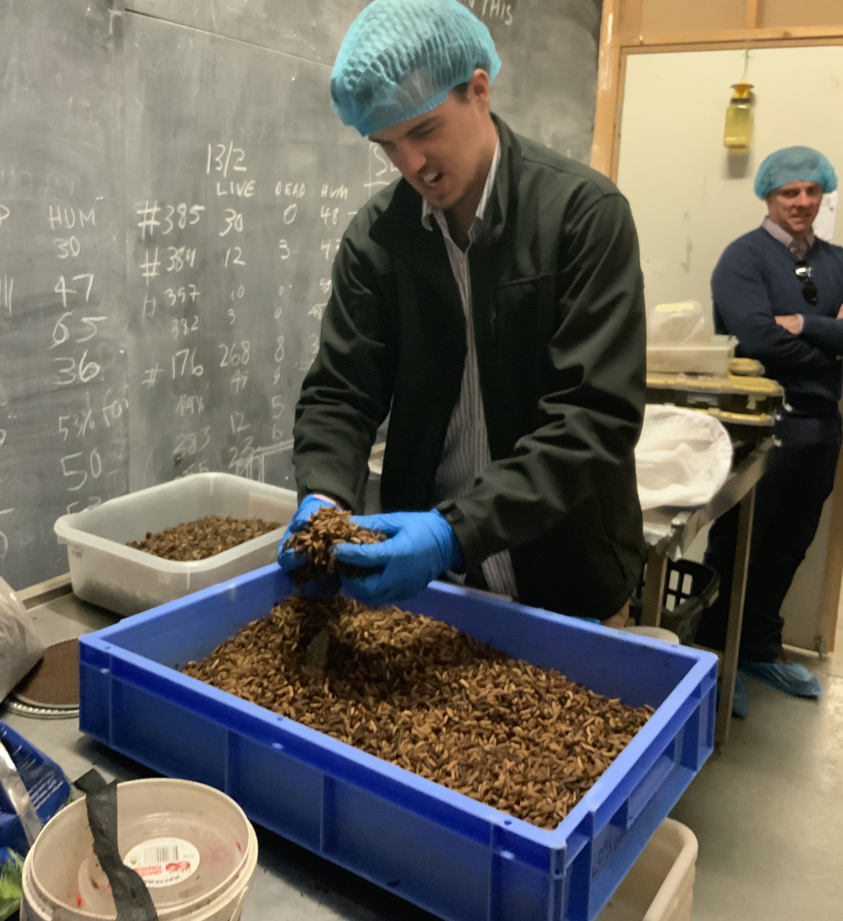
Question time

Slide 13


